Slide 1

ONLINE INTERVIEW MANAGEMENT SYSTEM
By:
Saisree E (46282521)
Vidyalakshmi D B (46282522)
Umajyothi Yeleti(46282336)
Mutyala Tharaka Saieswari (46282335)

Slide 2
CONTENT
Introduction
Requirements
Problem Statements
Functional Specifications
Technical Specifications
Flow chart
Modules
Benefits
Conclusion

Slide 3
INTRODUCTION
Interview Management System is a system for digitally managing the interviews of any individual. The project contains admin side where he can view all the applicants and companies. The companies and applicants can register and login to the system by providing the required credentials.
Companies can add, delete and modify their details in the system. And they can also add, delete and modify their recent openings.
Applicants can add their personal information, educational details, skills and experience.
The data provided by employees and companies will be stored in a file.

Slide 4
REQUIRMENTS
Problem Statement.
Functional Specifications.
Technical Specifications.

Slide 5
PROBLEM STATEMENT
The proposed solution is to design and develop an interview management system.
The system will contain an admin that will view and manage the entire interview process.
The system will replace the paper system into a digital system which would not require any hard copies and physical space for record keeping. The system will serve as the centralized database for all the records in the entire interview process. The system is easy and convenient to use.

Slide 6
FUNCTIONAL REQUIRMENTS
• All records are saved in a file.
• Key features of the system are:
Login as admin: there exists only one admin for the system
Register as new user: Any new applicant/company should be allowed to register to the system.
Login as user: Existing users can login to the system and perform the operations.

Slide 7
TECHNICAL SPECIFICATION
• Use data-structures for storing data before adding it to file (i.e, Linked list).
• Data Validation is implemented for phone number, email id, username, password,
company id, opening id, date.
• Write optimized logic for searching as time complexity should not get increased while
searching any information.
• For this we can store all the data in a file.

Slide 8
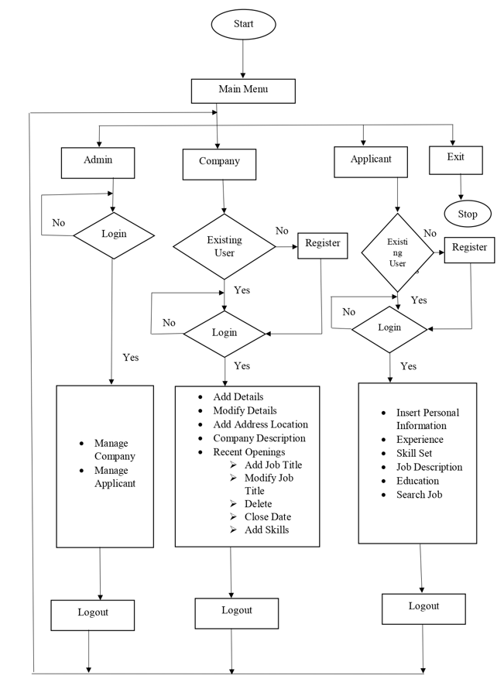
FLOWCHART

Slide 9
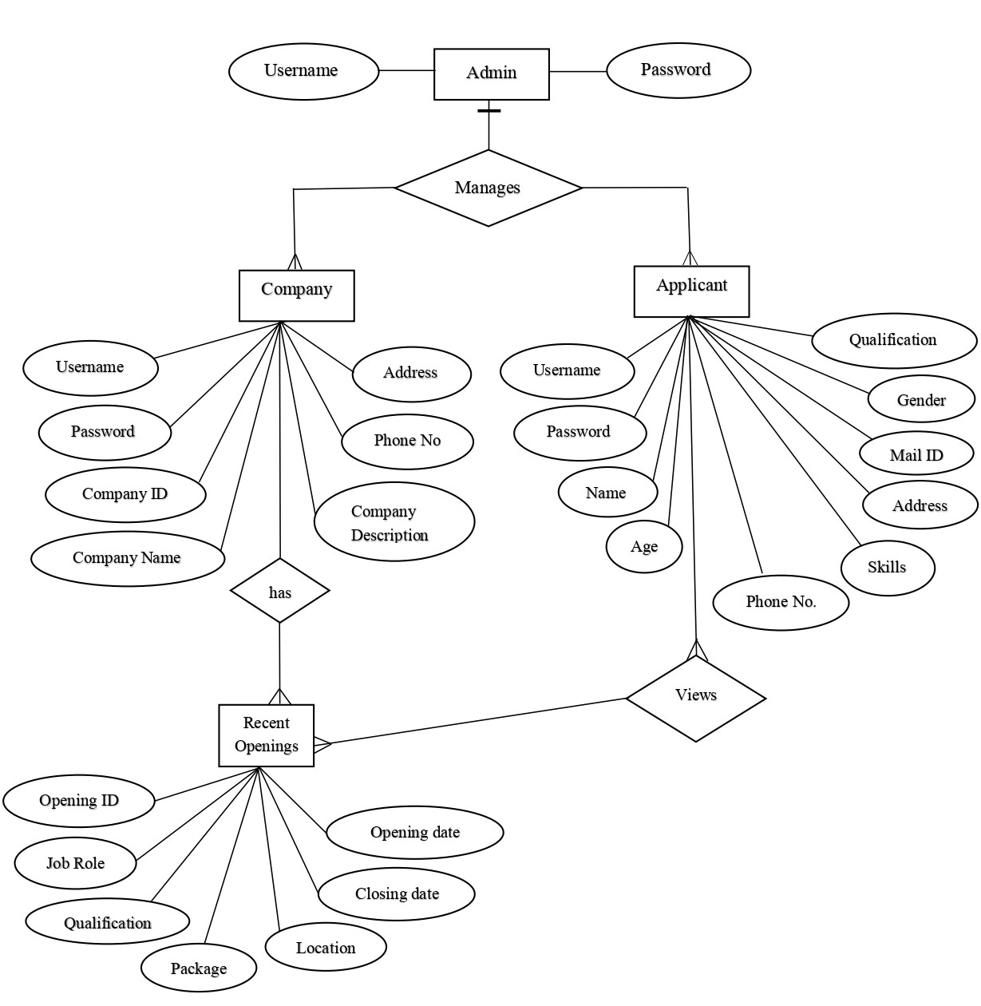
ER DIAGRAM

Slide 10
MODULES
There are 4 modules in this System
Admin Module
Company Module
Applicant Module
Data Validation Module

Slide 11
ADMIN MODULE
Admin will manage and view the entire interview process.
Admin can view and manage applicants and companies.

Slide 12
COMPANY MODULE
In company module, companies can register if they are a new users and then login to the system.
Companies can perform the operations such as add details, modify details, add recent openings, delete the details and give description about the company in the system.
This help them select right employees for the company. They could easily manage interview processes.

Slide 13
APPLICANT MODULE
In applicant module, applicant can register if he is a new user and then login to the system by providing the credentials.
Applicant can add his personal information such as username, password, email id, phone number, education details, experience and skill set.
Applicant can view the recent openings provided by the company.
This will also be very convenient on the part of the applicants since they can now apply for a job online.

Slide 14
DATA VALIDATION MODULE
Data validation is the process of verifying and validating data that is collected before it is used.
Any type of data handling task, whether it is gathering data, analysing it, or structuring it for presentation, must include data validation to ensure accurate results.
In the proposed system, data validation is done for username, password, email id, phone number, date, company id, applicant id of admin, company and applicant module.

Slide 15
TECHNOLOGIES USED
System C
C is a powerful general-purpose programming language. It can be used to develop software like
operating systems, databases, compilers, and so on.
Data Structures
Data Structures in C are used to store data in an organised and efficient manner. The C
Programming language has many data structures like an array, stack, queue, linked list, tree, etc.
Data structures make it easy for users to access and work with the data they need in appropriate
ways.
Linux
Linux is a Unix-like, open source and community-developed operating system (OS) for computers,
servers, mainframes, mobile devices and embedded devices. An operating system is the software
that directly manages a system's hardware and resources, like CPU, memory, and storage.

Slide 16
BENEFITS
Automation of entire process
Saves time
Accessibility.

Slide 17
TOOLS USED
gcc
Makefile
Valgrind
splint
vim editor

Slide 18
CONCLUSION
This system helps company to select right employees for their company. They could easily manage interview processes. The system will make their work easy.
This system will help to manage all documents related to the interview process easily. Automation can be very effective and efficient and will improve the business process in general. This will also be very convenient on the part of the applicants since they can now apply for a job online.

Slide 19
THANK YOU

